Slide 1
Self Balancing Platform A.K.A Magic Plank
Group II
Brian Jacobs
Kenneth (Rocky) Santiago Jr.
Stephen C Fraser II

Slide 2
Motivation
Engineer and implement a unique and challenging, yet feasible senior design project that is distinguishable from other projects.

Slide 3
Background (Segway)
The Segway personal transportation vehicle, is a two wheeled balancing platform that has seen applications in civilian and military fields.

Slide 4
Background (Project)
Engineer and implement a fully functional two wheeled self balancing platform.
Software governors to maintain max/min speed/acceleration, assisting in maintaining balance.
Explore, engineer, and implement wireless steering.

Slide 5
Background (Continued)
Elimination of the steering column sets the Magic Plank apart from a standard Segway.
Wheel orientation is altered due to the lack of the steering column, resembling more of a skateboard orientation than that of a Segway.
This change shifts the work load of the project heavily towards software.

Slide 6
Outline
Hardware Specifications
Microcontroller
Motor Controller
Bluetooth Device
Inertial Measurement Unit
PCB
Motors & Wheels
Power Supply
Software Design
Software Architecture
Class Diagrams
Sabertooth
IMU
Filter
Bluetooth
Wiimote Integration
Balancer
Administrative Information

Slide 7
Hardware Specifications

Slide 8
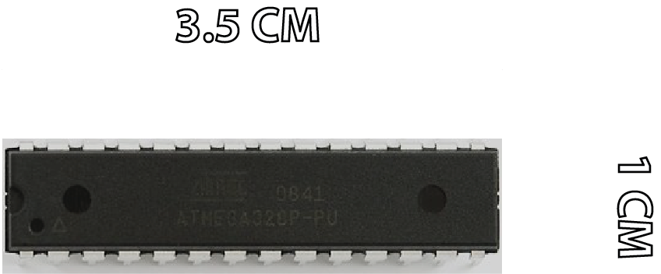
Atmel ATmega328p Microcontroller
Low power
Variable Performance
0 – 20 MHZ @ 1.8 – 5.5 V
1 MIPS / MHZ
Capable of running the
Arduino Software Platform

Slide 9
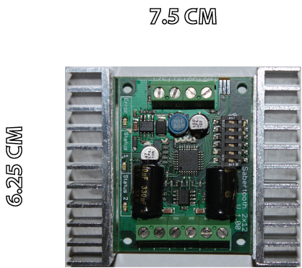
Sabertooth 2x12 Regenerative Dual Motor Driver
A very robust driver, capable of handling a heavy payload.
Supply power to two
DC brushed motors,
12 A nom, 18 A peak.
Thermal Protection
Compatible controls:
PWM
Radio Control
Serial and Packetized Serial
Notes:
Able to supply power to two DC brushed motors

Slide 10
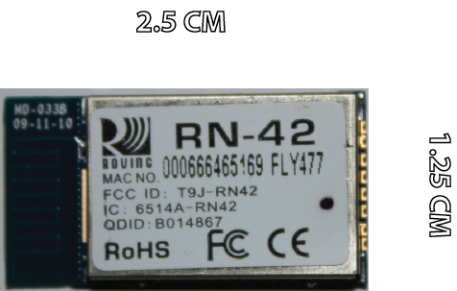
Bluetooth SMD Module RN-42
Mounted onto Bluetooth Mate Silver
Includes power regulator
Low Power (45 mA)
3.3V operation
Delivers up to 3 Mbps data rate for up to 20 meters (60 ft).
Bluetooth Technology
V2.0 compatible.

Slide 11
SMD Module RN-42 Communication
Utilizes UART and USB data communication interfaces.
Auto-discovery/pairing requires no software configuration.
Embedded Bluetooth stack profiles included: GAP, SDP, RFCOMM, and L2CAP.

Slide 12
Steering Implementation
Nintendo Wii Wireless Controller, AKA Wiimote, mounted on the Nintendo Wii Steering Wheel.
Powered by two AA batteries.
Will behave as a standard steering wheel.
Operated remotely.

Slide 13
Nintendo Wiimote
Communicates via a Bluetooth Wireless link
Utilizes a Broadcom 2042 controller chip, designed to be used with devices which follow the Bluetooth Human Interface Device (HID) standard
Transmits information via HID input packets
HID data packets received and interpreted by code running on laptop computer.

Slide 14
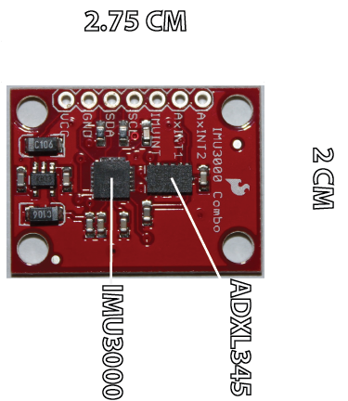
Inertial Measurement Unit IMU3000 & ADXL345
6 Axis Inertial
Measurement Unit
3.3V operation
I²C Communication
Small profile

Slide 15
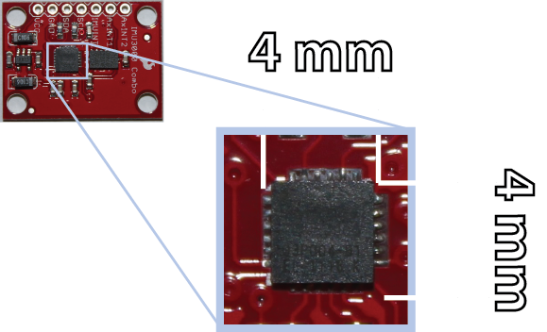
Inertial Measurement Unit IMU3000
IMU3000 is a 3-axis gyro
with programmable
ranges:
+/- 250 to +/- 2000 deg/sec
Operates ADXL345
via secondary I²C,
only 1 I²C bus needed
to communicate with
microcontroller

Slide 16
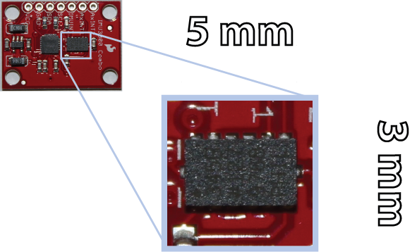
Inertial Measurement Unit ADXL345
ADXL345 is a 3-axis
accelerometer with
programmable ranges:
+/- 2 to +/- 16 g
3.3V operation
I²C Slave to IMU3000

Slide 17
Printed Circuit Board Schematics

Slide 18
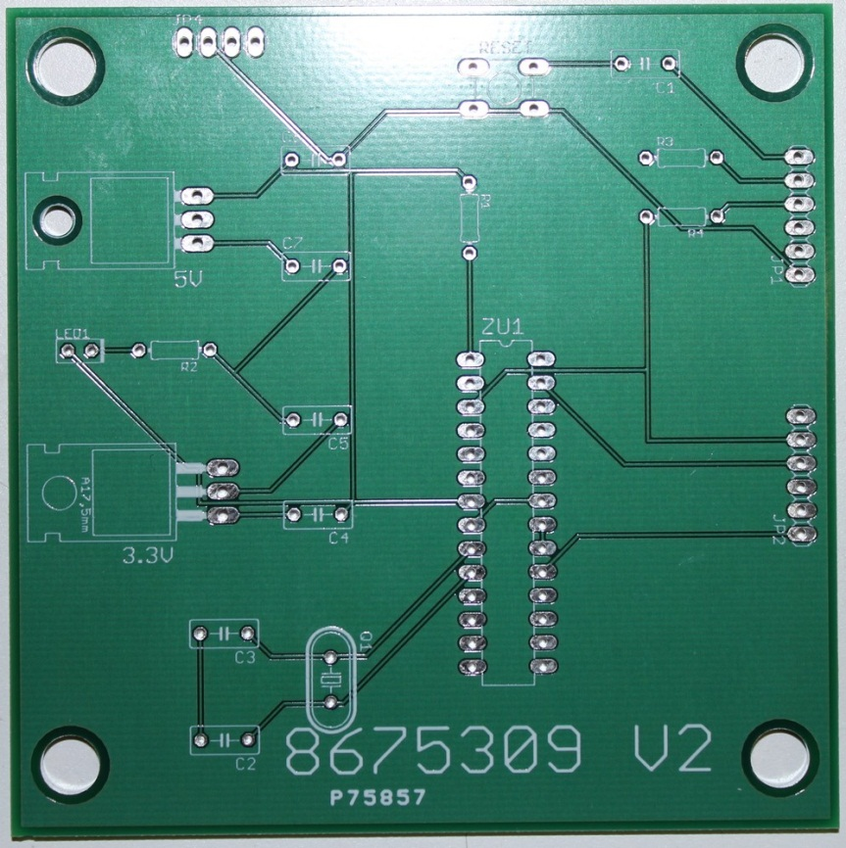
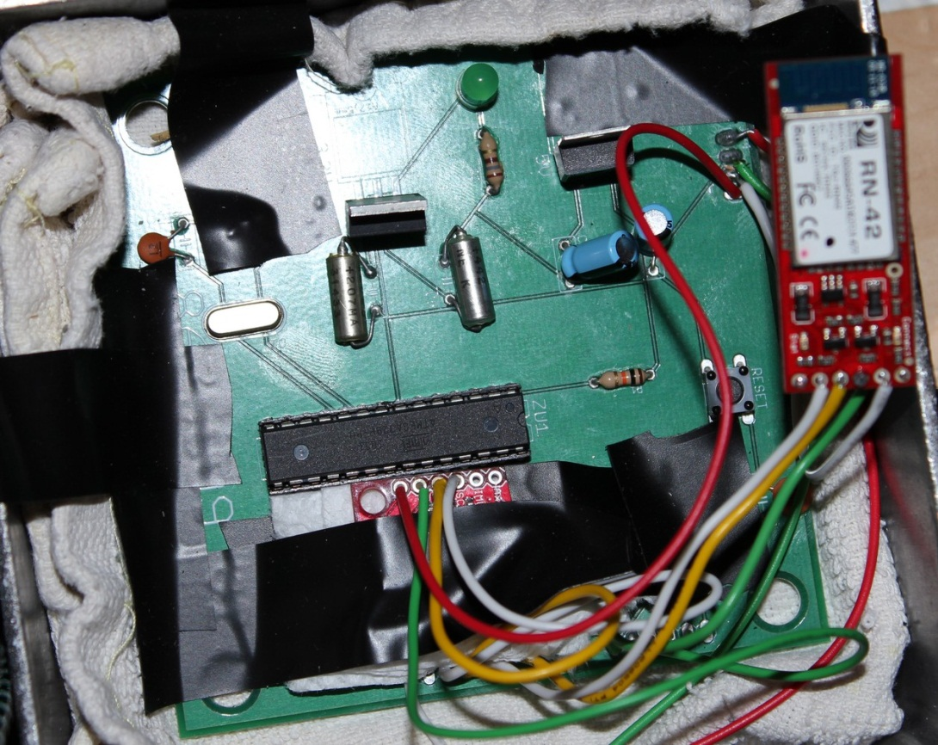
Printed Circuit Board
Runs the ATmega328p
Pinouts for the IMU3000 and Bluetooth RN-42

Slide 19
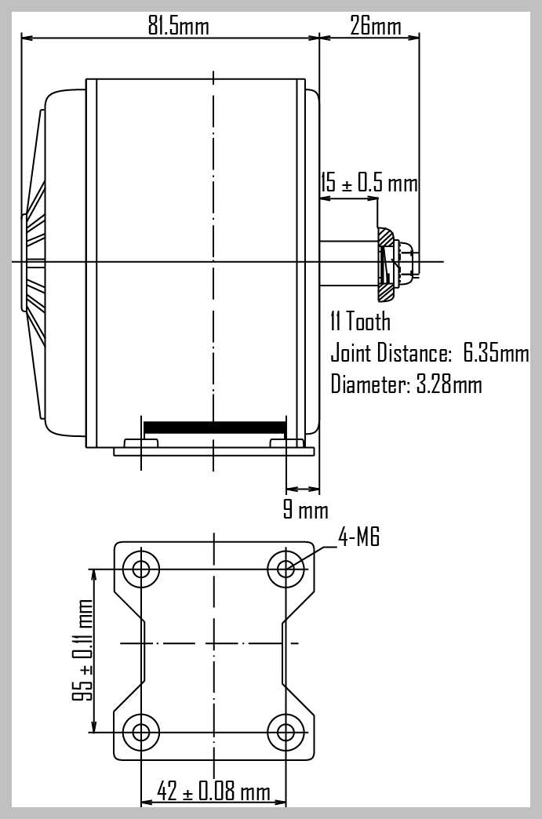
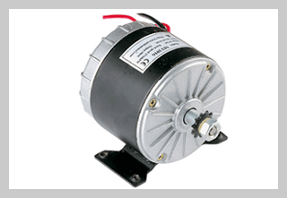
24 Volt 250 Watt Electric Motor
Type: Brushed DC
Rated Speed:
2600-2850 RPM
Rated Current:
13.5-13.7 Amp

Slide 20
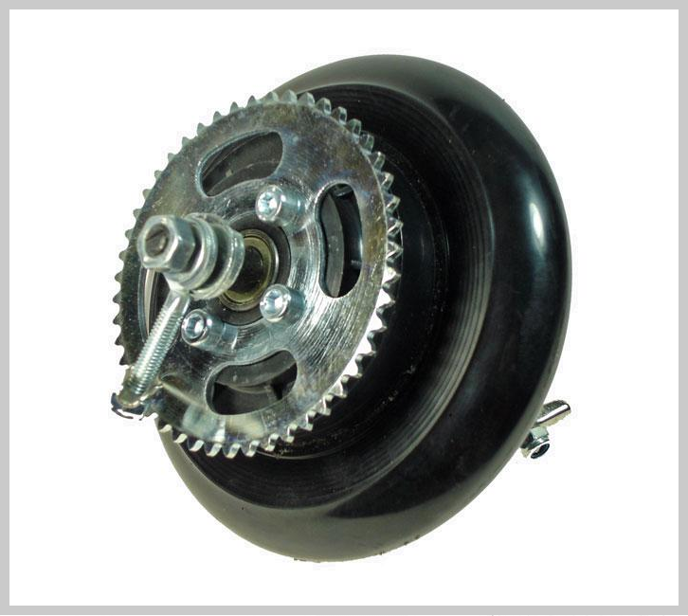
Chain Drive Wheel Assembly
Overall Diameter:
143.5mm
Overall Width:
56.3mm
Sprocket:
#25 chain, 47 tooth
Sprocket Offset:
27mm

Slide 21
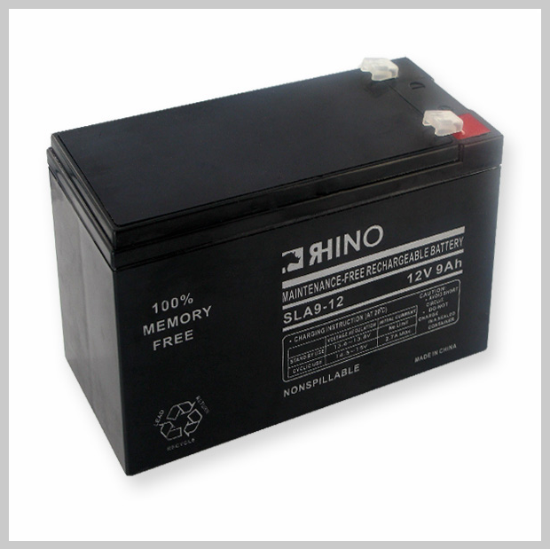
9 Ah 12 V Power Supply
Style: AGM
Length: 5-7/8”
Width: 2-1/2”
Height: 3-3/4”
Weight: 7 lbs
( x 2 = 14 lbs )
Will provide estimated
30-45 min. battery life

Slide 22
Software Design

Slide 23
Software Overview: Architecture

Slide 24
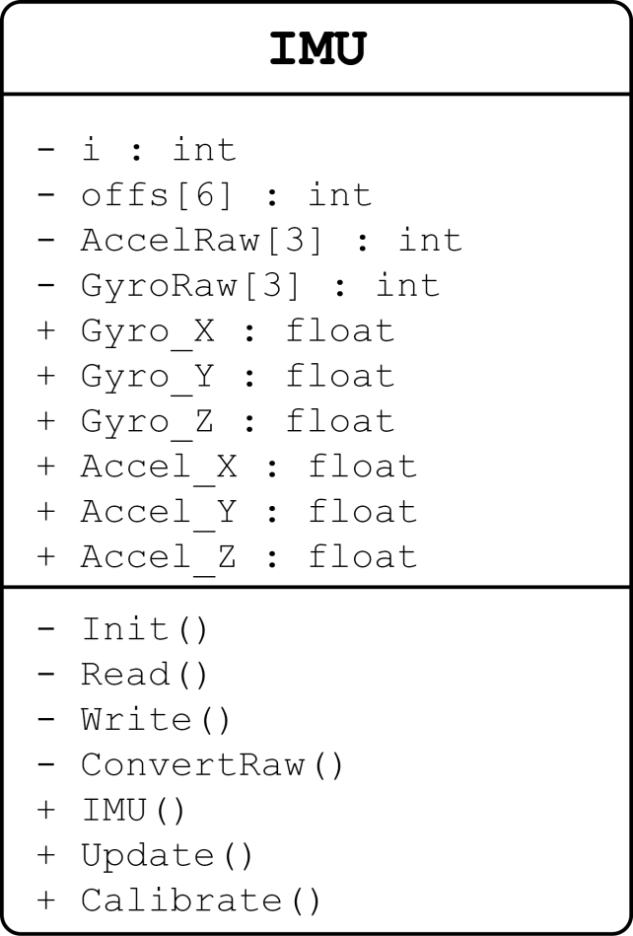
Software Design IMU
Communication using I²C
Fetch Gyro and Accel values
stored in the IMU3000 regs
Calibrate using data offsets
Convert raw data to
angular rate (deg/s)
and acceleration (g’s)

Slide 25
Software Design IMU
$Fx=Araw ∗\frac{Arange}{2^{Resolution}}$
Accel operates at a 10-bit resolution
Accel configured for +/-2g range (4gs)
$δ_{X}=\frac{Graw}{[\frac{2^{Resolution}}{Grange}]}$
Gyro operates at a 16-bit resolution
Gyro configured for +/- 250 deg/s range (500 deg/s)

Slide 26
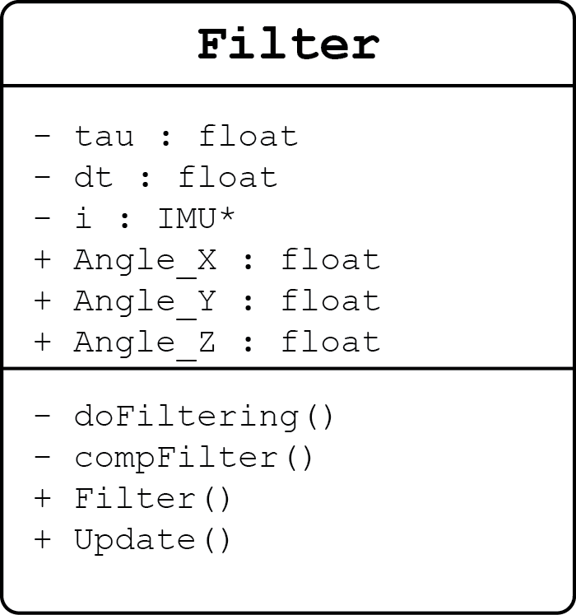
Software Design Filter
Takes raw values from IMU
Filter out accelerometer’s
vibrational noise and the
gyroscope’s drift
Calibrate using data offsets
Outputs current angle
(or projected angle) using
combined accel and gyro data

Slide 27
Software Design Determining Angles
$R= \sqrt{{F_{X}}^{2}+{F_{Y}}^{2}+ {F_{Z}}^{2} }$
R is the accelerometer’s force vector
${θ_{Accel}= cos}^{−1}\left(\frac{F_{X}}{R}\right)− \frac{π}{2}$
Accelerometer’s X-Axis
$θ_{Gyro}= θ_{Gyro}+ \frac{δ_{X}∗δ_{T}}{1000}$
Gyroscope’s X-Axis

Slide 28
Software Design The Complementary Filter
The equations:
x = τ / ( τ + dt )
Θ = x * ( θ + g * dt ) + ( 1 – x ) * a
τ = temporal influence of gyro / accel
Larger τ means more gyro input (less vibration artifacts)
Smaller τ means more accelerometer influence (faster drift correction)
dt = time elapsed between readings
a = new acceleration force in g’s
g = new gyro angle rate in deg/s
θ = current (old) calculated angle
Θ = new calculated angle
Filtering is time sensitive
If dt > τ, drift is corrected
If dt < τ, translation is suppressed

Slide 29
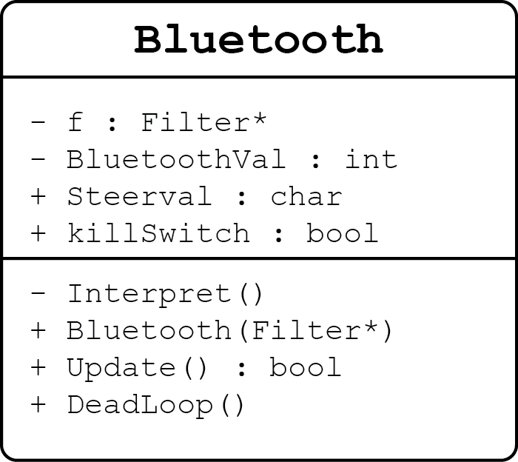
Software Design Bluetooth
Gets raw data from
Bluetooth device
Converts raw data into
steering commands
Handles dead-man switch and revive command

Slide 30
Wiimote Data Reports
The Wii Remote has a number of different data reporting modes. Each of these modes combines certain Core data features with data from external peripherals, and sends it to the host through one of the report IDs, determined by the mode.
A hexadecimal data packet is sent out every time a value of one of the reported features has changed.
An example packet:
(a1) 30 00 08
(a1): indicates this packet as input from the Wiimote
0x30: shows the data report mode as 0x30, which in this case reports only button input
0x00 and 0x08: show which buttons have been pressed, with this particular combination indicating that the A button is currently being held down.

Slide 31
Wiimote Accelerometer Data
The Wii Remote includes a three-axis linear accelerometer located on the top surface of the circuit board.
Measures accelerations over a range of at least +/- 3g with 10% sensitivity
Data from the accelerometer is sent in a packet utilizing the following format: (a1) 31 BB BB XX YY ZZ
XX, YY, and ZZ are unsigned bytes representing the acceleration in each of the three axis.

Slide 32
Wiimote Interpreter
Program written in C#
Receives data packets from the Wiimote using the Wiimotelib library.
Requests the numerical representation of the status of the Y-axis of the Wiimote and converts it to a number which can be added directly to the motor speed.
Also receives button status which can be interpreted as a command to kill or revive the motors.

Slide 33
Software Dead-Man Switch
Controlled by the Wiimote
Implemented to ensure the safety of its operators and bystanders
The B button located on the back of the Wiimote must be held down at all times in order to keep the Magic Plank in motion
The moment the button is released, the Plank terminates operation of the motors until an additional command is received (sent by holding down the B button and pressing the 2 button) which will revive the Magic Plank and resume functionality.

Slide 34
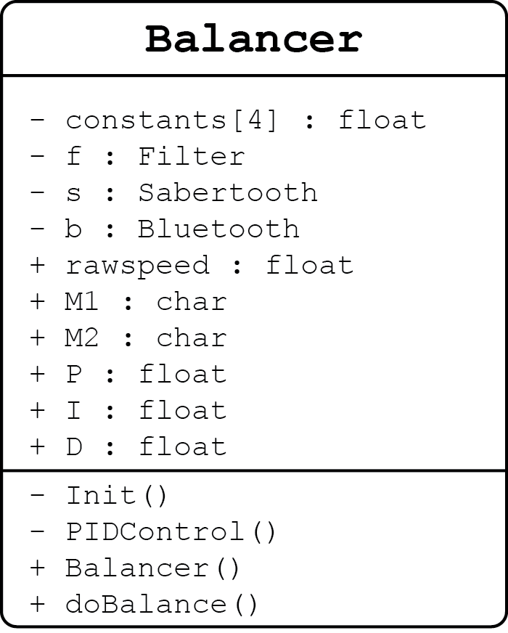
Software Design Balancer
Manages Filter, Sabertooth,
and Bluetooth classes
Balances platform using
PID control
Offsets balance with turning
data from Bluetooth, moves
motors while maintaining
equilibrium

Slide 35
Software Design PID Control
PID : Proportional Integral Derivative Control
P = Directly proportional to the current angle
I = Integral of the angle as a function of time (prevent over-correction)
D = Derivative, the change in time (accounts for rapid change)
Kp,Ki,Kd = Constants that weight the influence of P, I, and D

Slide 36
Software Design Balancer
$P=Kp ∗ θ$
$I=I+ Ki ∗ θ ∗0.99$
$\text{0.99 }\text{is} \text{used} \text{to} \text{bring} \text{I} \text{back} \text{to}\text{ 0 }\text{when} \text{the} \text{angle} \text{is} \text{near}\text{ 0}$
$D=δ_{X}$
where $δ_{X}$ is the rate of change from the Gyro (deg/s)
$Level=P+I+D$

Slide 37
Software Design Balancer
Once the Level is determined, steer commands are integrated into the motor commands
$M1 =Level+Steerval$
$M2 =Level −Steerval$
Offsetting the values allows for the platform to maintain balancing equilibrium

Slide 38
Administrative Information

Slide 39
Initial Budget (Prototyping)

Slide 40
Final Budget

Slide 41
Questions?

